Slide 1
Neural Networks

Slide 2
Artificial Neural Network
Mimics the Parallel interconnections, that exist between the neurons of the brain.
Synaptic connection strengths among neurons are used to store the acquired knowledge.
1 op 10^-9: processor vs 10^-3: neuron. Yet neurons are faster for complex tasks such as: Face recognition, natural speech.
Why? The network is massively parallel.

Slide 3
Artificial Neural Network
Neural Network: Set of simple, analog signal processors connected by links, where each link has a numeric weight.
It resembles the brain in two respects:
Knowledge is acquired by the network from its environment through a learning process
Synaptic connection strengths among neurons are used to store the acquired knowledge.

Slide 4
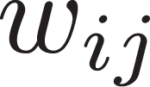
O_1
O_2
O_n
Output Layer
Time is discretized
t
Slab or Layer
t-1
Neuron i
t-2
I_1
I_2
I_n
Input Layer

Slide 5
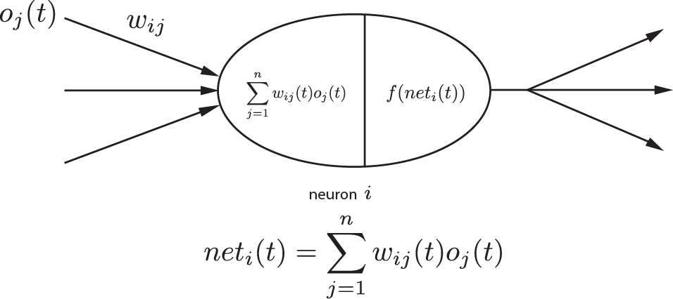
Activation function when a_i(t) = net_i(t)
Input from another
neuron j or source
Weight associated
To link
Is the function f non-linear?
Output value is
Then propagated
The input is modulated by the weight

Slide 6
Each unit receives stimulation from other units, except the input layer.
The signal received is modulated by the weighting value of the connection.
The modulated inputs are then integrated. (summed)
An activation value is determined. (I don’t understand how? Separate function F they don’t talk much about.)
ai(t) = Fi(ai(t-1), net_i(t)). F is not activation function!

Slide 7
The output value is calculated with an activation function, which takes as input the activation value.
f_i(a_i(t)) or f_i(net_i(t)) if a_i(t) = net_i(t)
The output value is then propagated to other neurons. This output value is input value to other neurons.
This activation function can be of different types: linear, binary threshold… etc…

Slide 8
Vector talk, I don’t understand.
Net_i = o * w_i
||o|| ||W_i|| * cos(theta)
Inner Product == Dot Product?
Inner product of a and b, is the projection
Of a on b
a
b

Slide 9
Linear input
Sum of everything that goes in goes out.
f_{i}^{l}(net_i(t)) = net_i(t)
Applications:
Fan out units – signal distriburtion (unaltered)
Linear combiner – pattern multiplexing
Analog Output device – signal produced is to be interpreted by another network unit or by the outside world as a continuous variable indicator ?

Slide 10
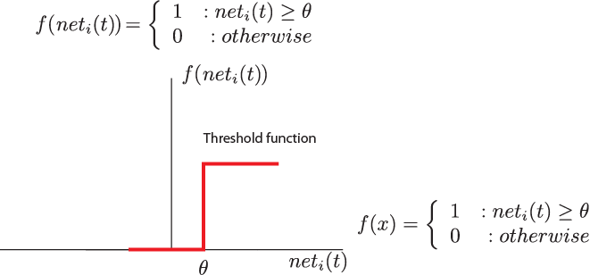
Threshold Function
1
0
Hard Limited output
Only two possible outputs 0 or 1
= 0.4
0.0
0.2
0.3
-0.2

Slide 11
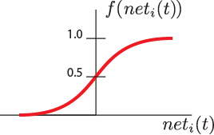
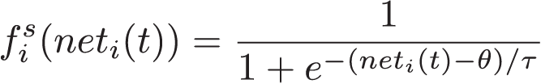

Sigmoid Function
Two stable states with a transition region.
Mathematically continuous
Many possible functions.

Slide 12
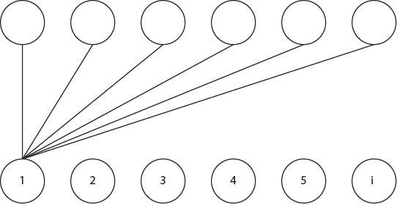

Competitive function
Outstar:
Only 2 states (active, inactive)
When active it transmits a memory pattern
When inactive, it transmits nothing
Instar:
Excited only by specific input patterns
They compete among themselves.

Slide 13
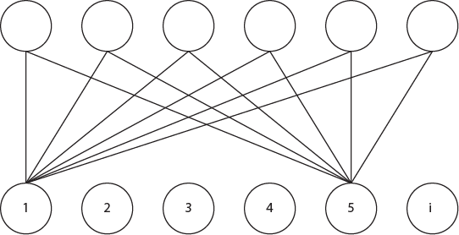
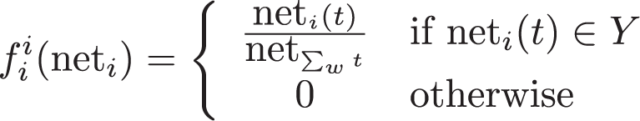
Interpolation Function

Slide 14
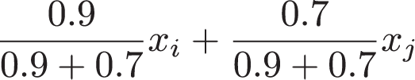
x_i + x_j
x_i
x_j

Slide 15

Gaussian Function
Acts as a filter, allowing only input patterns that produce activations within a very narrow range to pass.
\sigma is the smoothing factor

Slide 16
O1
Output layer
t
0.6
-0.8
H1
H2
Feature detectors
t-1
0.7
0.3
0.6
0.4
I1
I2
Filters for input signals
t-2
How do they arrive to this?
O(t) = (I1(t-2)+I2(t-2))*~(I1(t-2)*I2(t-2))
Either one gives activates
Both are necessary to activate

Slide 17
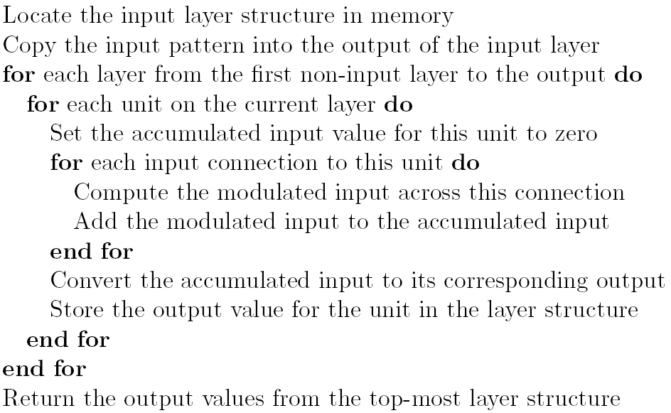
Algorithm

Slide 18
O_1
O_2
O_n
Output Layer
Time is discretized
t
Slab or Layer
t-1
Neuron i
t-2
I_1
I_2
I_n
Input Layer

